Slide 1
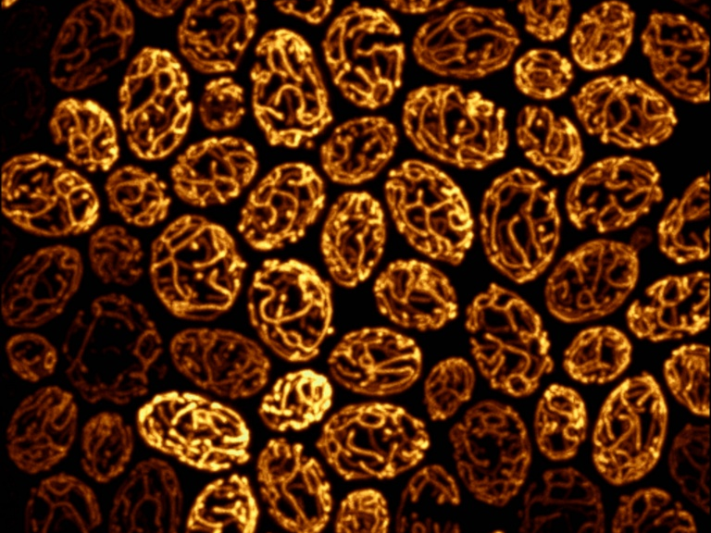
Designing a Microscopy Experiment
Kurt Thorn, PhD
Director, NIC@UCSF
Image from Susanne Rafelski, Marshall lab

Slide 2
Sample preparation and mounting
Mounting media serve several purposes:
Stabilizing the sample
Preventing photobleaching
Clearing the sample
Matching refractive index

Slide 3
Index Mismatch
& Spherical Aberration
objective
n₁
Immersion
fluid
Cover glass
n₂
Sample
Focus at cover slip
Focus
into sample
Spherical aberration
unless n₂ = n₁

Slide 4
Index Mismatch
& Spherical Aberration
z=0 µm
n₁=1.515 (oil)
z=25 µm
n₂=1.44
(Vectashield)
z=50 µm

Slide 5
What can you do about spherical aberration?
Use 0.17 mm coverslips (~ #1.5)
Work close to the coverslip
Match lenses to the refractive index of your samples, and vice versa
For aqueous samples, use water immersion / water dipping lenses
For fixed samples and oil immersion lenses, mount your sample in a medium with n = 1.515
Adjust objective correction collar when available
Use lower NA lenses

Slide 6
Clearing
Clearing media dissolve lipids to make samples more transparent
Can be important for thick samples and tissues
Commonly used:
BABB = 1:2 Benzyl Alchohol : Benzyl Benzoate
Methyl Salicylate

Slide 7
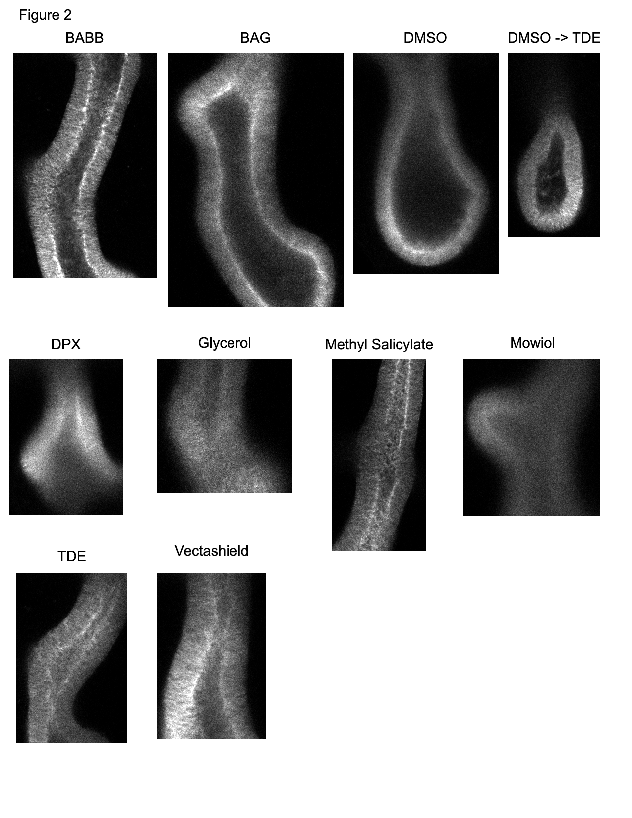
Sample Preparation
Samples imaged with 20x / 0.75 air objective on spectral confocal
Sections acquired ~ 50 μm into tissue
Embryonic mouse lungs; samples from Nan Tang, Martin Lab

Slide 8
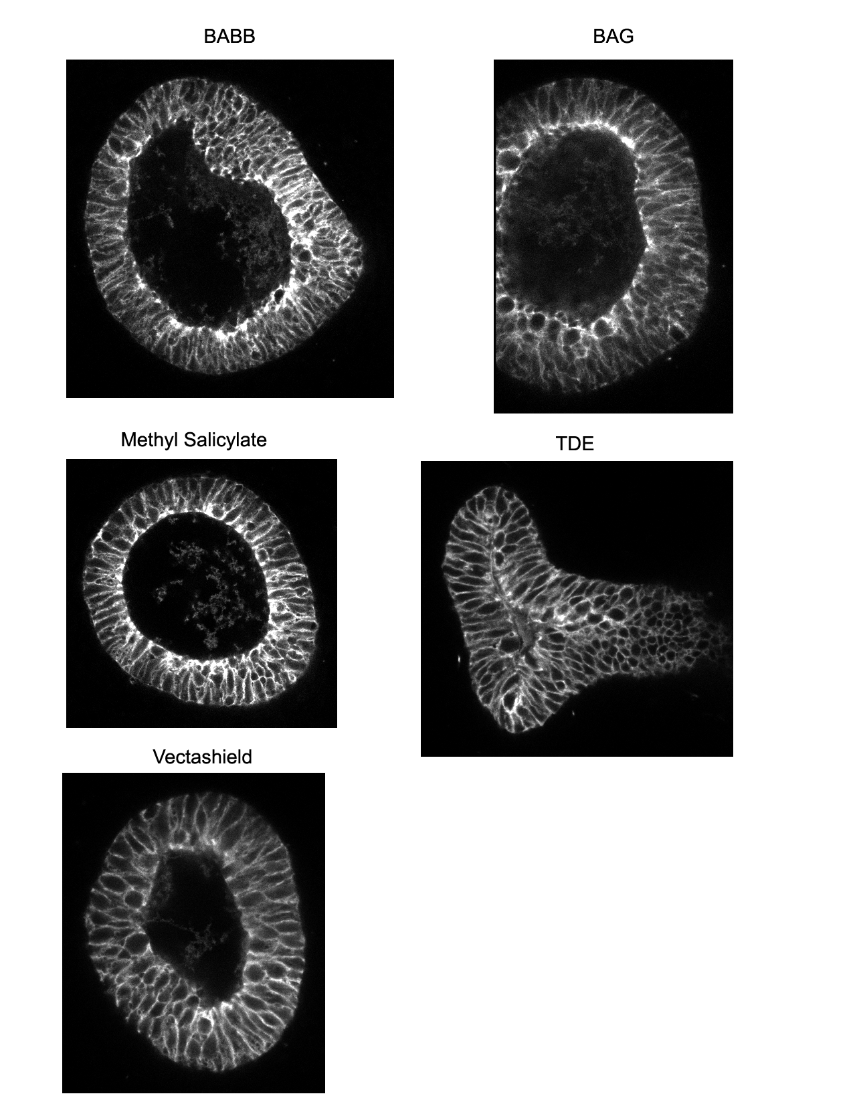
Sample Preparation
Samples imaged with 40x / 1.3 oil objective on spectral confocal
Sections acquired ~ 50 μm into tissue
Embryonic mouse lungs; samples from Nan Tang, Martin Lab

Slide 9
Dye choices – Fixed samples
Common filter set is DAPI / FITC / Rhodamine / Cy5
Dye choices:
DAPI / Hoechst / Alexa 350 / Alexa 405
Alexa 488
Rhodamine / Alexa 546 / Alexa 568
Cy5 / Alexa 647 / Atto 647
More than four colors probably requires special filters or spectral imaging.

Slide 10
Dye choices – Live samples
Common filter sets: GFP / mCherry, CFP / YFP, CFP / YFP / RFP
Two-color choice: GFP / mCherry
Three-color: CFP / GFP / mCherry or CFP / YFP / mCherry or BFP / GFP / mCherry
Four-color: BFP / CFP / YFP / mCherry or Sapphire / CFP / YFP / mCherry
Five-plus colors: possible but tricky, probably requires custom filters or spectral imaging.
Consider new RFP variants: mRuby, mApple

Slide 11
Time and noise - tradeoffs
The number of photons collected by the camera generally determines the amount of noise in your image
Noise = square root (# of photons)
Doubling signal to noise ratio requires 4-fold increase in exposure

Slide 12
What does this look like?
With 5 e⁻ camera read noise
1000 photons / pixel
100 photons / pixel
10 photons / pixel

Slide 13
Noise and resolution
Theoretical perfect data
Two spots separated by diffraction limit
Slightly oversampled

Slide 14
Noise and resolution
With shot noise
1000 ph/pixel at peak
100 ph/pixel at peak
10 ph/pixel at peak

Slide 15
Noise and resolution
Expected error bars with shot noise
1000 ph/pixel at peak
100 ph/pixel at peak
10 ph/pixel at peak

Slide 16
Noise and resolution
High resolution and precise quantitation both require lots of light
This means bright samples or long exposures
This may cause problems with photobleaching and phototoxicity
Be aware of potential tradeoffs between precision, speed, and photobleaching

Slide 17
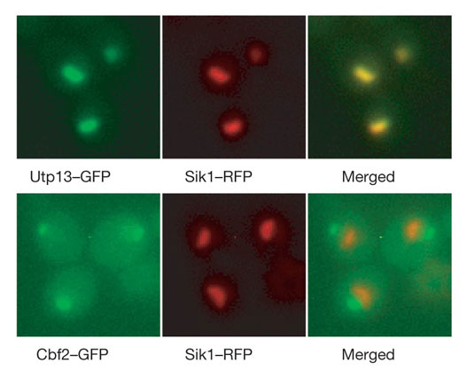
Colocalization
Measures co-occurrence within the resolution limit of the microscope.
Does not say anything about molecular interaction
Huh et al. 2003

Slide 18
Nothing beats good data
Think about what data you need before you take it.
Do you need
Time resolution?
Spatial resolution?
Intensity resolution?
Day-to-day reproducibility?
Spatial uniformity?
You can fix a lot of problems with post-processing, but it’s better to fix problems in the data collection!

Slide 19
If you care about it, you should measure it!
Spatial uniformity
Illumination and detection is not uniform over the field of view of the microscope.
Can be measured and corrected with a shading image.
Photobleaching may make this hard
Temporal uniformity
Lamp power and alignment fluctuates from day to day
Can measure
But best to do experiments same day / same session

Slide 20
Background correction
Cameras have a non-zero offset
There can also be background fluorescence due to media autofluorescence, etc.
Want to correct for this by background subtraction
Camera dark image
Estimate background from image

Slide 21
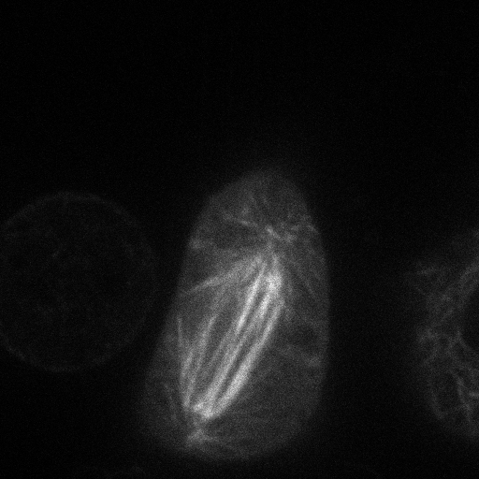
Estimating background from image
Number
Pixel Intensity

Slide 22
Dark image
Acquired with no light going to the camera
Allows you to measure instrument background
Can detect what’s real background autofluorescence

Slide 23
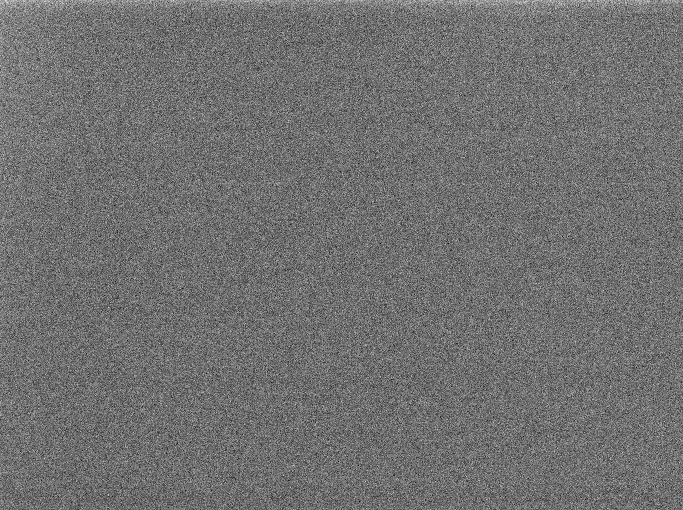
Dark image

Slide 24
Shading correction
Measure and correct for nonuniformity in illumination and detection
Image a uniform fluorescent sample

Slide 25
Shading correction

Slide 26
Correction procedure
I_{meas} = I_{true} * Shading + Dark
I_{true} = (I_{meas} – Dark) / Shading
Good to do on all images

Slide 27
Think about data storage
Databases are good, but cumbersome
Save in manufacturer’s native format so metadata is preserved
If not using a database, systematic file names and notes on sample identity are a good idea

Slide 28
File Formats and Bitdepth
Digital cameras have a specified bitdepth = number of gray levels they can record
8-bit → 2⁸ = 256 gray levels
10-bit → 2¹⁰ = 1024 gray levels
12-bit → 2¹² = 4096 gray levels
14-bit → 2¹⁴ = 16384 gray levels
16-bit → 2¹⁶ = 65536 gray levels

Slide 29
Bitdepth and file formats
Standard imaging formats, like tiff, are always 8 or 16 bit (because 8 bits = 1 byte)
16 bit value (0-65535)
0
0
0
0
12 bit data (0-4095)
0
0
0
0
12 bit data (0-65535)
but counting by 16s

Slide 30
Color Images
Color images are made up of three gray scale images, one for each of red, green, and blue
Can be 8 or 16 bits per channel

Slide 31
File Formats
Most portable: TIFF
8 or 16-bit, lossless, supports grayscale or RGB
Most metadata: Manufacturer format (nd2, ids, etc.)
Lossless, supports full bitdepth
Custom formats often support multidimensional images
Not so portable
OK: JPEG2000
Not so common
Bad: JPEG, GIF, BMP, etc.
Lossy and / or 8-bit

Slide 32
Intensity scaling
Computer screens are 8-bit
Publishers also want 8-bit files
255
Final Intensity
0
0
4095
Original Intensity
You lose information in this process –
values 4080-4095 all end up as 255

Slide 33
Intensity scaling
Max
255
Contrast
Final Intensity
Brightness
0
0
4095
Original Intensity
Min

Slide 34
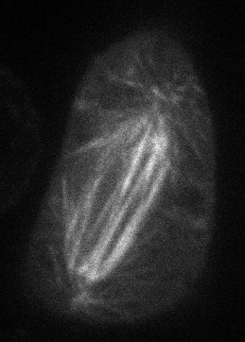

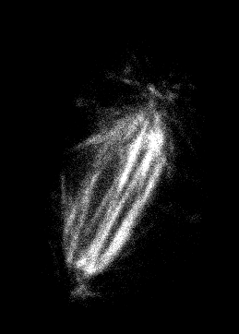
Effect of scaling
Scaled to min / max
(874 / 25438)
(874 / 19200)
(6400 / 18432)
Drosophila S2 cell with mCherry-tubulin (Nico Stuurman)

Slide 35
Gamma correction
γ=0.45
Output Intensity
γ=2.2
γ=1
Input Intensity
Other contrast stretching transforms….

Slide 36
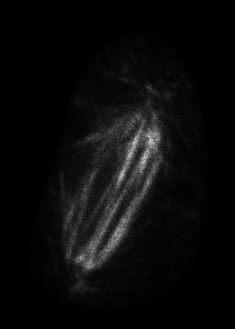
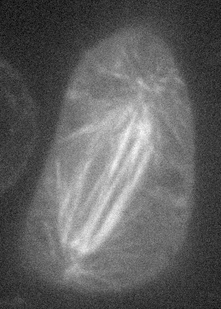
Effect of gamma
Scaled to min / max
(874 / 25438), γ = 1
Scaled to min / max
(874 / 25438), γ = 2.16
Scaled to min / max
(874 / 25438), γ = 0.45

Slide 37
What are acceptable image manipulations?
JCB has the best guidelines
http://jcb.rupress.org/misc/ifora.shtml#image_aquisition
http://jcb.rupress.org/cgi/content/full/166/1/1
Brightness and contrast adjustments ok, so long as done over whole image and don’t obscure or eliminate background
Nonlinear adjustments (like gamma) must be disclosed
No cutting and pasting of regions within an image (e.g. individual cells)

Slide 38
References
Slides: http://nic.ucsf.edu/edu.html

